Slide 1
JAVA Architecture
Presented by THIVYA SHREE

Slide 2
JAVA programming
Java is an object-oriented, class-based, secured and general-purpose computer-programming language.
Java follows the principle of WORA (Write Once, Run Anywhere) and is platform-independent.

Slide 3
JAVA Architecture
There are three main components of Java architecture
JVM
JRE
JDR

Slide 4
JVM(Java VIRTUAL MACHINE)
Java combines both the approaches of compilation and interpretation.
First, java compiler compiles the source code into bytecode.
JRE is the implementation of Java Virtual Machine (JVM), which analyzes the bytecode, interprets the code, and executes it.
JVM stands for Java Virtual Machine, which is used to interpret an entire program line by line. This can handle the run time exception.

Slide 5
The main feature of Java is WORA. WORA stands for Write Once Run Anywhere.
Each operating system has different JVM, however the output they produce after execution of bytecode is same across all operating systems.
That is why we call java as platform independent language.
JVM has the following tasks:
Load code
Verify code
Execute code

Slide 6
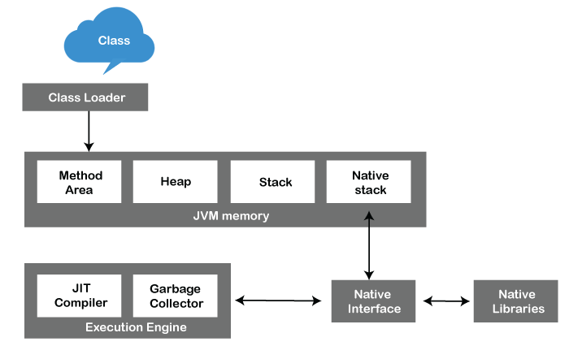

Slide 7
ClassLoader: ClassLoader is a subsystem used to load class files. ClassLoader first loads the Java code whenever we run it.
Class Method Area: In the memory, there is an area where the class data is stored during the code's execution. Class method area holds the information of static variables, static methods, static blocks, and instance methods.
Heap: The heap area is a part of the JVM memory and is created when the JVM starts up. Its size cannot be static because it increase or decrease during the application runs.
Stack: It is also referred to as thread stack. It is created for a single execution thread. The thread uses this area to store the elements like the partial result, local variable, data used for calling method and returns etc.

Slide 8
Native Stack: It contains the information of all the native methods used in our application.
Execution Engine: It is the central part of the JVM. Its main task is to execute the byte code and execute the Java classes.
Interpreter: It converts the byte code into native code and executes
JIT Compiler: JIT compiler is introduced to remove the drawback of the interpreter. It increases the speed of execution and improves performance.
Garbage Collector: The garbage collector is used to manage the memory, and it is a program written in Java.

Slide 9
JRE(Java Runtime Environment)
It plays a key role while executing any java application.
It is a collection of tools that together allow the development of applications and provide a runtime environment.
The JVM is a part of JRE.

Slide 10
JDK(Java Development Kit)
JDK includes Development Tools to provide an environment to develop your Java programs and JRE to execute your java code.
In order to create, compile and run Java program you would need JDK installed on your computer.

Slide 11
BYTECODE
Bytecode in Java is a set of instructions for the Java Virtual Machine.
Bytecode is a platform-independent code. Bytecode is a code that lies between low-level language and high-level language.
After the Java code is compiled, the bytecode gets generated, which can be executed on any machine using JVM.

Slide 12
STACK MEMORY
Stack Memory in Java is used for static memory allocation and the execution of a thread.
It contains primitive values that are specific to a method and references to objects referred from the method that are in a heap.
Access to this memory is in Last-In-First-Out (LIFO) order.
Whenever we call a new method, a new block is created on top of the stack which contains values specific to that method, like primitive variables and references to objects.

Slide 13
HEAP MEMORY
Heap space is used for the dynamic memory allocation of Java objects and JRE classes at runtime.
New objects are always created in heap space, and the references to these objects are stored in stack memory.

Slide 14
THANK YOU

